Slide 1
Chapter 5
Enthalpy

Slide 2
1. Which one of the following conditions would always result in an increase in the internal energy of a system ________?
A) The system loses heat and does work on the surroundings.
B) The system gains heat and does work on the surroundings.
C) The system loses heat and has work done on it by the surroundings.
D) The system gains heat and has work done on it by the surroundings.
E) None of the above is correct.

Slide 3
2. Which one of the following statements is true __________?
A) Enthalpy is an intensive property.
B) The enthalpy change for a reaction is independent of the state of the reactants and products.
C) Enthalpy is a state function.
D) H is the value of q measured under conditions of constant volume.
E) The enthalpy change of a reaction is the reciprocal of the ΔH of the reverse reaction.

Slide 4
3. The reaction
4Al (s) + 3O₂ (g) → 2 Al₂O₃ (s) ΔH° = -3351 kJ
is __________, and therefore heat is __________ by the reaction.
A) endothermic, released
B) endothermic, absorbed
C) exothermic, released
D) exothermic, absorbed
E) thermoneutral, neither released nor absorbed

Slide 5
4. Under what condition(s) is the enthalpy change of a process equal to the amount of heat transferred into or out of the system __________?
(a) temperature is constant
(b) pressure is constant
(c) volume is constant
A) a only
B) b only
C) c only
D) a and b
E) b and c

Slide 6
5. The British thermal unit (Btu) is commonly used in engineering applications. A Btu is defined as the amount of heat required to raise the temperature of 1 lb of water by 1 °F. There are __________ joules in one Btu. 1 lb = 453.59 g; °C = (5/9)(°F - 32°); specific heat of H₂O(l) = 4.184 J/g-K.
A) 3415
B) 60.29
C) 1054
D) 5.120 × 10⁻³
E) Additional information is needed to complete the calculation.

Slide 7
6. A 22.44 g sample of iron absorbs 180.8 J of heat, upon which the temperature of the sample increases from 21.1 °C to 39.0 °C. What is the specific heat of iron __________?
A) 0.140
B) 0.450
C) 0.820
D) 0.840
E) 0.900
180.8/(22.44*17.9)

Slide 8
7. Of the following, ΔH_{f}° is not zero for __________.
A) O₂ (g)
B) C (s, graphite)
C) N₂ (g)
D) F₂ (s)
E) Cl₂ (g)

Slide 9
8. Consider the following two reactions:
A → 2B ΔH°_{rxn} = 456.7 kJ/mol
A → C ΔH°_{rxn} = -22.1 kJ/mol
Determine the enthalpy change for the process: __________
2B → C
A) -478.8 kJ/mol
B) -434.6 kJ/mol
C) 434.6 kJ/mol
D) 478.8 kJ/mol
E) More information is needed to solve the problem.

Slide 10
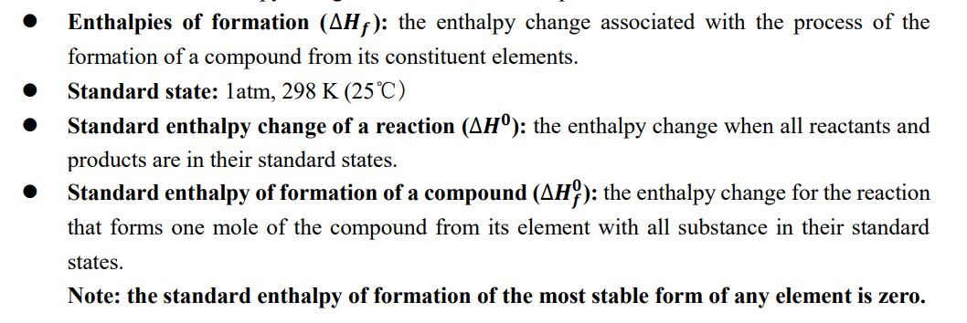
9. For which one of the following reactions is the value of ΔH°_{rxn} equal to ΔH_{f}° for the product __________?
A) 2 C (s, graphite) + 2 H₂ (g) → C₂H₄ (g)
B) N₂ (g) + O₂ (g) → 2 NO (g)
C) 2 H₂ (g) + O₂ (g) → 2 H₂O (l)
D) 2 H₂ (g) + O₂ (g) → 2 H₂O (g)
E) H₂O (l) + 1/2 O₂ (g) → H₂O₂ (l)

